Slide 1
Update on Mathematical model of Kinase and Substrate Interaction
Saqib Rizvi

Slide 2
Convention
Abbreviations
Polyproline and substrate vector: P-S
SH3 and Kinase vector: H-K
keff is defined for rate constants that differ from the original rate constants due to proximity in our case
k2
k-2
k1
k-1

Slide 3
All possible states
P-S (polyproline-substrate)
H-K (SH3-Kinase)
PH_{K}-S (Polyproline bound to SH3 domain but substrate is free)
P-SK_{H} (Substrate bound to the kinase domain but Polyproline is free)
PH_{K}-SK_{H} (Both the polyproline and substrate domains are bound to an SH3 and kinase domain but the SH3 and kinase domain are from different molecules)
PH=SK (two substrate and kinase vectors are bound together)

Slide 4
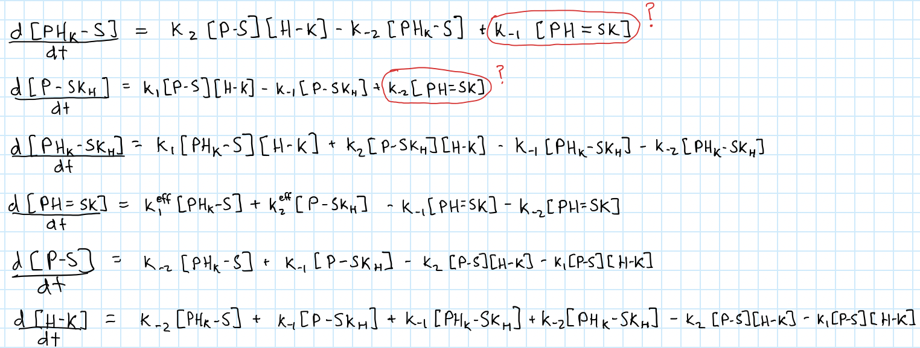
Equations

Slide 5
Future/Ongoing Work
Solving equations in MATLAB
Tried using the dsolve command to solve the system of differential equations
May have to solve numerically
Factoring in the effective linker length to account for entropy
Finding actual values for k through literature search

